Slide 1

Networking 1
The Handsome Seastars

Slide 2
Routing Information Protocol
The Handsome Seastars

Slide 3
Background Information
One of the oldest distance-vector routing protocols; IPv4 only
Simplifies routing -- no more traditional routing tables
v1 defined under RFC 1058
No support for router authentication
All subnets must be same size
Massive traffic each 30 sec. with RIP update
Hop count serves as routing metric
Networks with 16+ hops not supported; 16 hops = destination unreachable

Slide 4
RIP Messages
2 types of messages:
Request: when turning on; asks for routing table
Response: to Request or when Update timer expires
Processing received route entries:
If no local copy exists, entry + sender information is automatically added to routing table
If copy exists but hop count lower, local hop count is updated
If copy exists but hop count higher, local hop count set to 16 (infinite), packets forwarded to old route, Holddown timer started

Slide 5
RIP Timers
4 types:
Update: interval between Response Messages (30)
Invalid: lifespan of a non-updated routing entry (180)
Flush: interval between Invalid/Unreachable designations and removal of route from table (180+60 sec advertising period; 240)
(CISCO ONLY) Holddown: per route entry; blocks entry updating to stabilize route (180)

Slide 6
RIPv2
RFC 2453
IPv4 only
Developed in 1993 to replace RIP
Supports subnet information and CIDR
15 hops or less; but adjustable
Routing table is multicasted (to specific addresses) not broadcasted (to everyone).
1997: MD5 authentication (insecure!)
Will be superseded by RIPng

Slide 7
RIPng
RFC 2080
Routing Information Protocol, Next-Gen
Extended to support IPv6
No more authentication; use IPsec instead, which is included in IPv6
Next hop is included into each route entry
Updates multicasted on UDP port 521

Slide 8
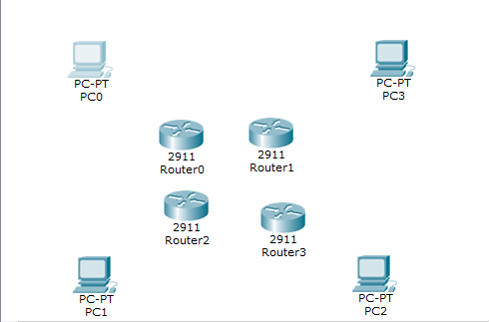
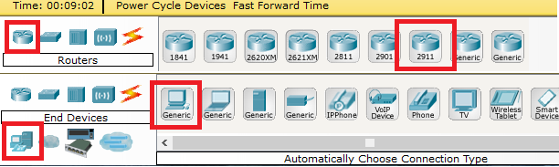
Setting Up

Slide 9
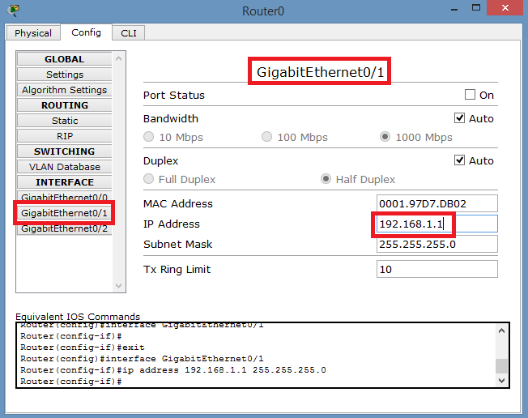
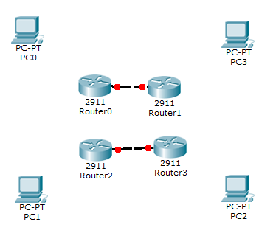
Horizontal Wiring

Slide 10
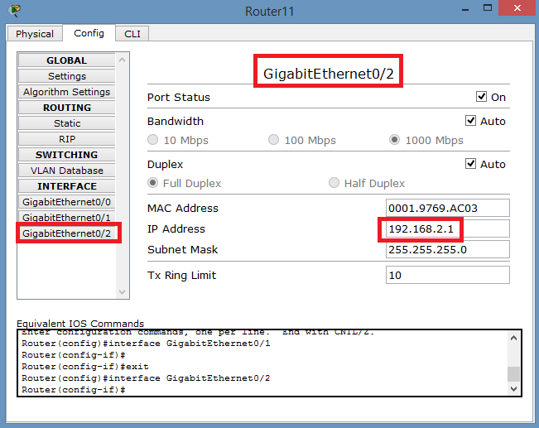
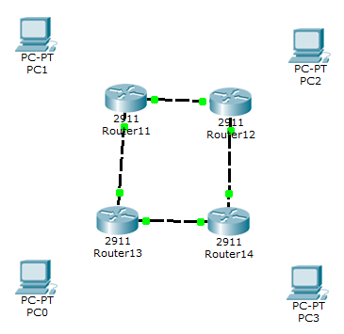
Vertical Wiring

Slide 11
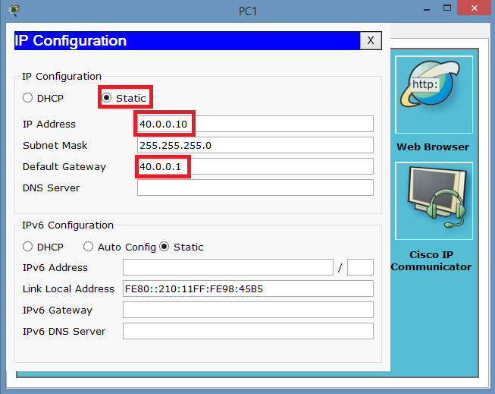
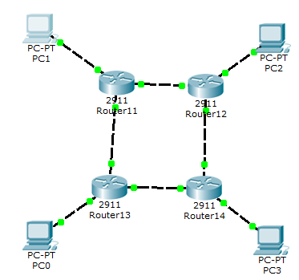
Computer Connections I

Slide 12
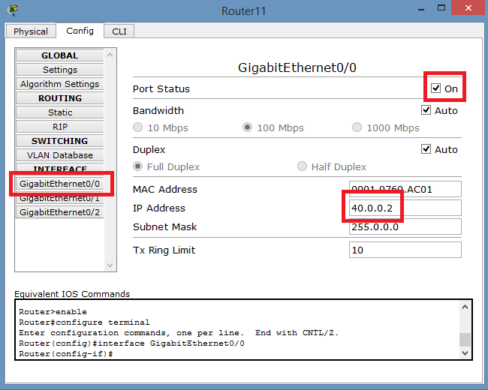
Computer Connections II

Slide 13
ACL
The Handsome Seastars

Slide 14
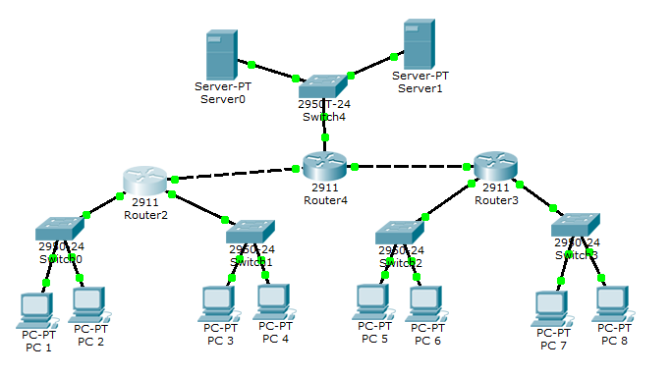
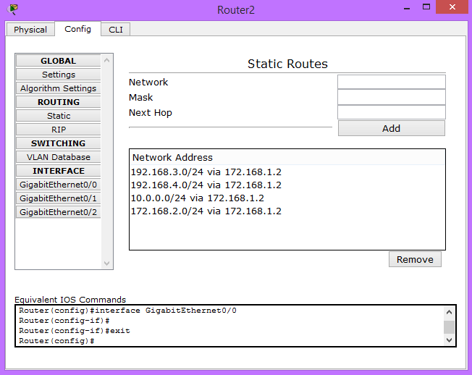
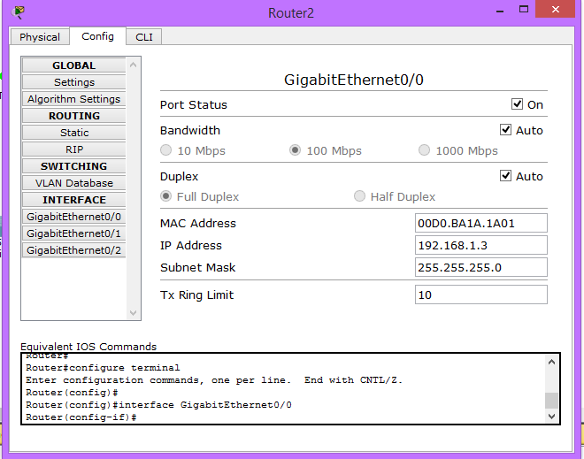
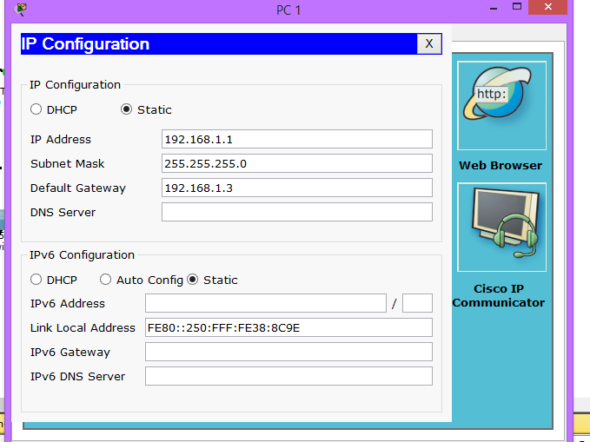
Setting up the Network
We started by placing all the end devices, switches, and routers and properly wiring to the correct ports
Next we opened each device and input its IP Address, Subnet Mask, and Default Gateway that we had planned ahead of time
Next we added in the IP Address and Subnet mask for each port in the routers
Finally we entered in all the static routes

Slide 15
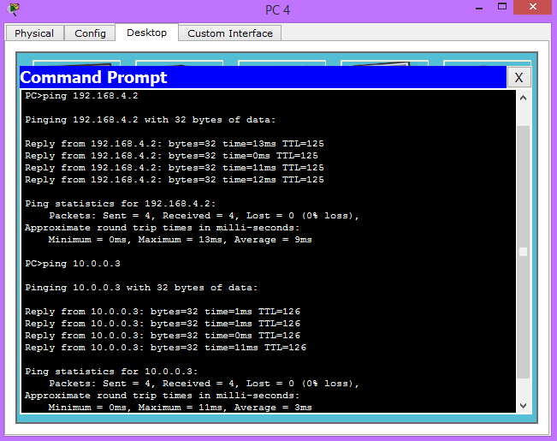
Testing the Network
We can ping across the routers, the switches, and from the PCs to the Servers

Slide 16

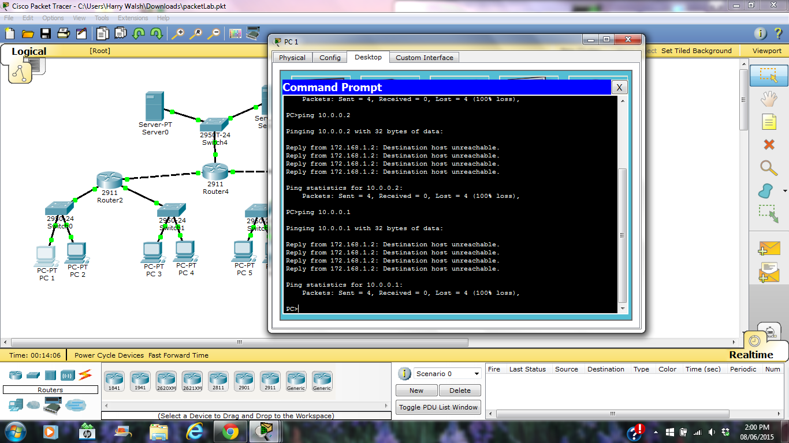
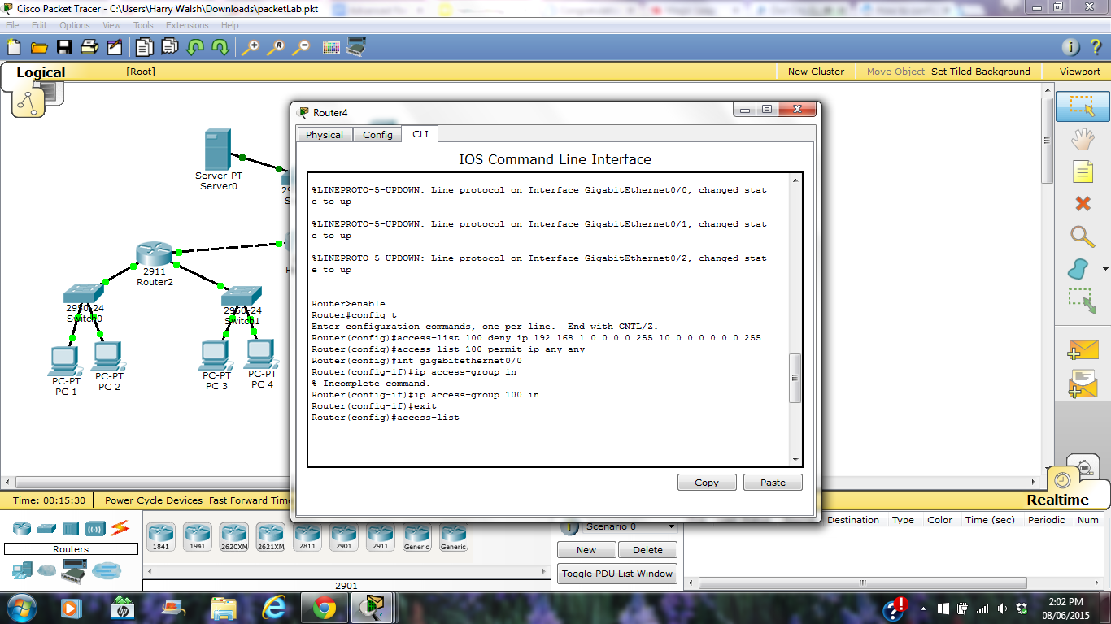
Deny level network to the server network
By using an extended ACL, we can block 192.168.1.* from accessing 10.0.0.*

Slide 17
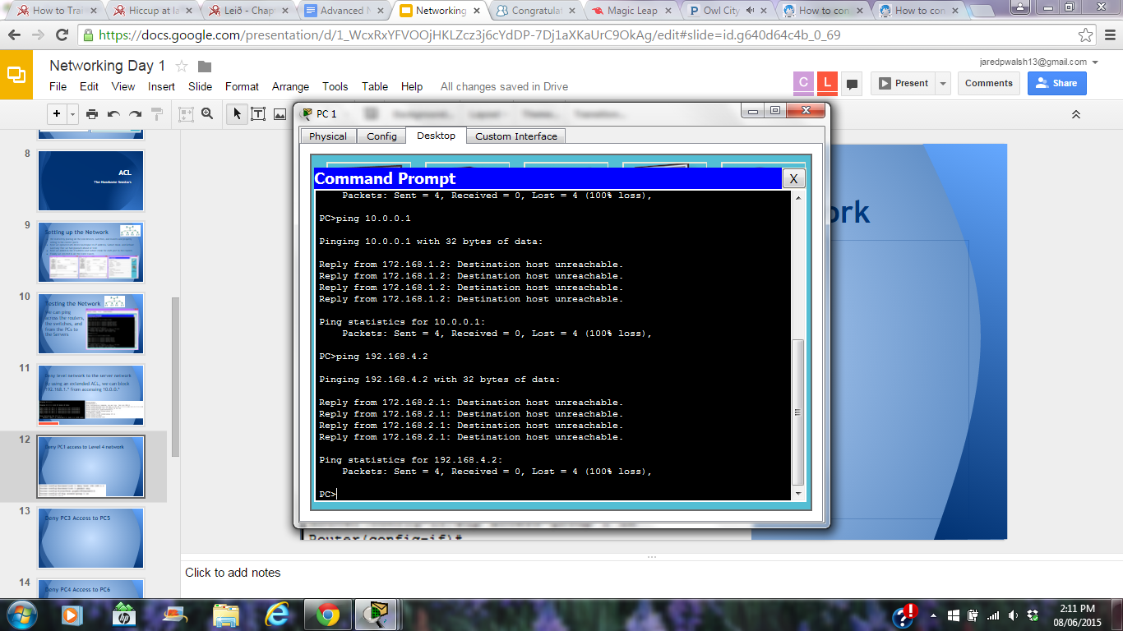
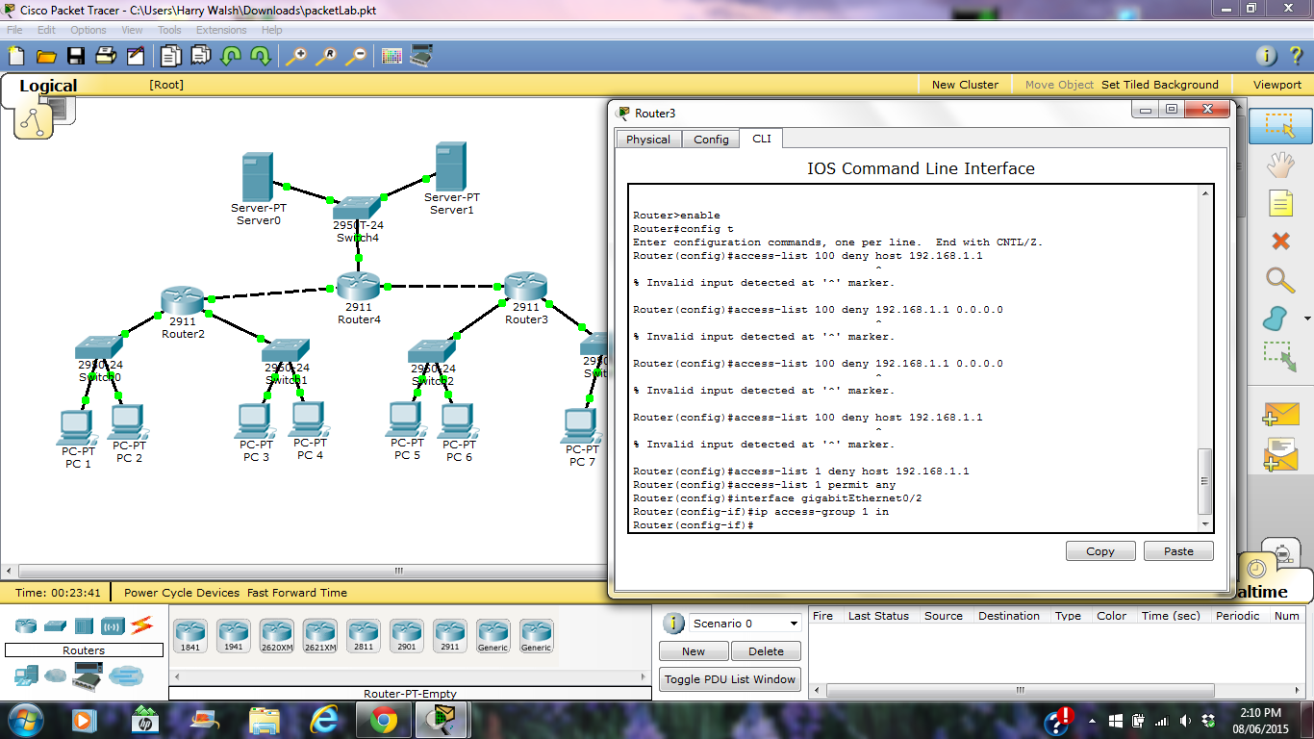
Deny PC1 access to Level 4 network
This time, we used a simple ACL to block 192.168.1.1 from accessing 192.168.4.*

Slide 18
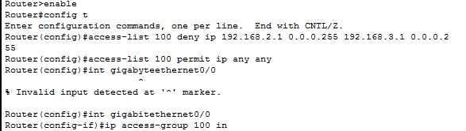
Deny PC3 Access to PC5
Same thing as the first, except this time we are using exact IPs instead of broad IP ranges

Slide 19
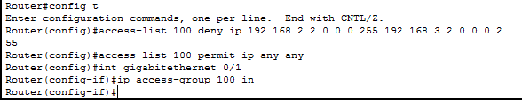
Deny PC4 Access to PC6
Same thing as before but with different IPs. Be sure to access the correct port, the one the connection will be passing through.

Slide 20
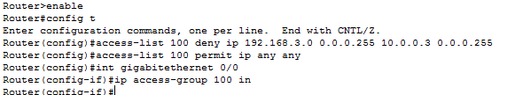
Deny Level 3 Network access to Server 3
More mass blocking but this time we need to add the ACL to the router between 192.168.3.0 and 10.0.0.3

Slide 21
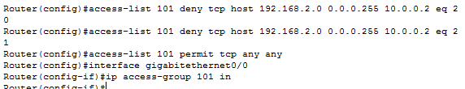
Deny FTP access to Server2 from Level 2 Network
An extended ACL let’s us specify a port, and FTP uses both ports 20 and 21, so by blocking the usage of those ports from 192.168.2.* to 10.0.0.2, we block FTP

Slide 22
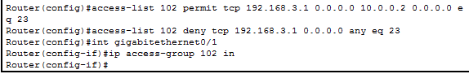
Only allow PC5 telnet access to Server2
in the Level 3 Network
Again, by using an extended ACL, we can specify the telnet port (23) and first permit 192.168.3.1 to access 10.0.0.2 with telnet, and then deny 192.168.3.1 from using telnet for anything.

Slide 23
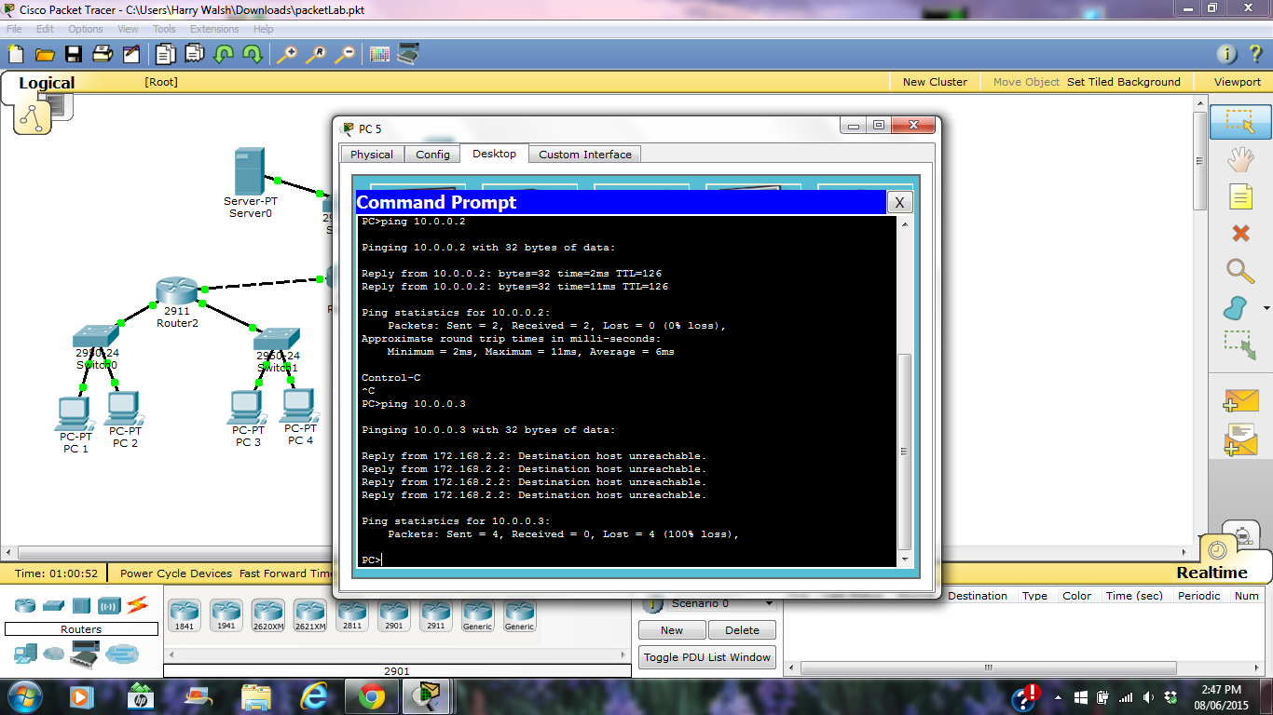
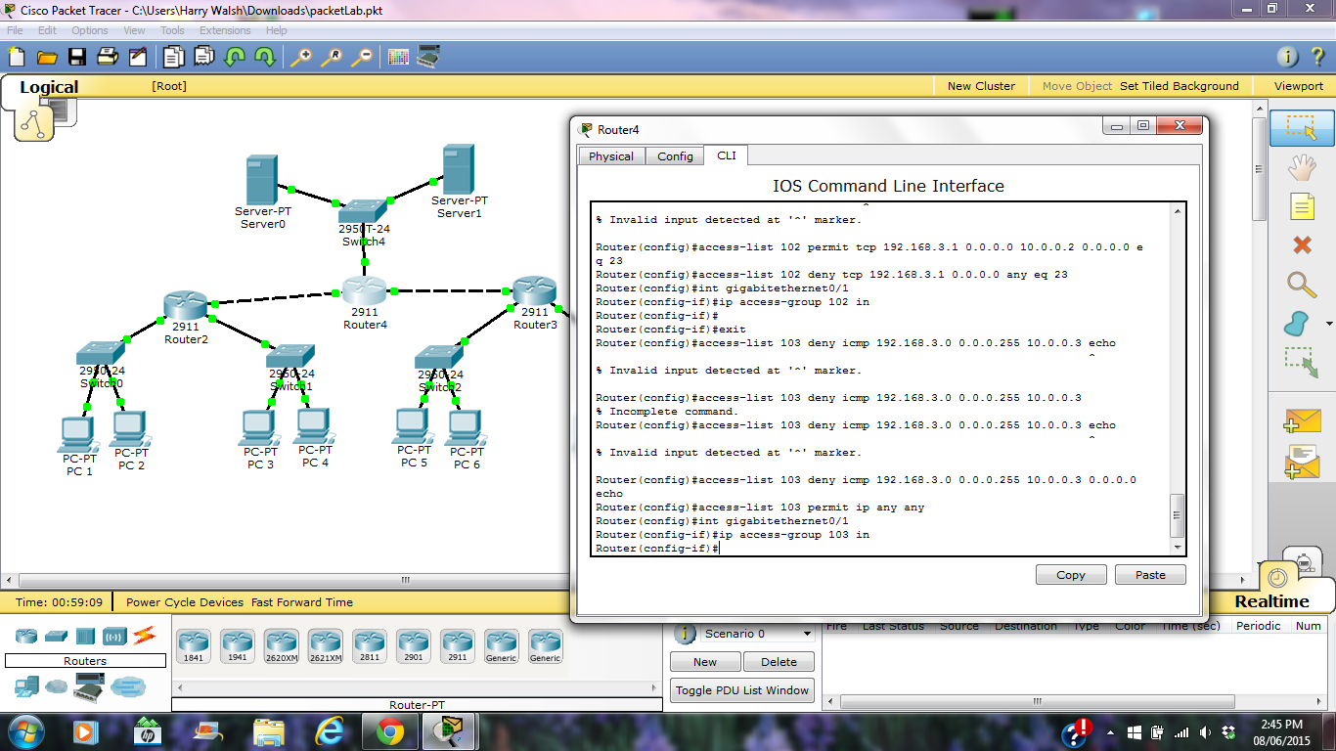
Deny Level 3 network ping to Server3
Yet again, we use extended ACL and block the icmp protocol with SRC=192.168.3.* and DST=10.0.0.3

Slide 24
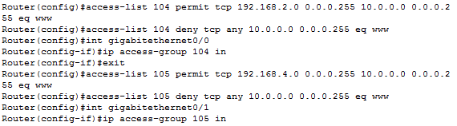
Only allow Level 2 & 4 Web access to the Server Network
Once more, we use an extended ACL to permit tcp if the request eq (equals) www from 192.168.2.* or 192.168.4.* to 10.0.0.* . Otherwise, all www requests are blocked.

Slide 25
Email
The Handsome Seastars

Slide 26
A little background info
Early ‘60s-conceived text-only communications medium for US GSA’s AUTODIN and DoD’s ARPANET
Today’s centralized email from MIT’s 1965 Compatible Time-Sharing System
RFC 561 (modern email encoding standard) first proposed 1973
Originally ASCII-only, then extended by MIME and soon Unicode UTF-8
Will allow support for non-Roman emails
Get ready for emoji...

Slide 27
More info
Backbone of email used to be extended FTP
Now Simple Mail Transfer Protocol (SMTP)
Under 1982 Request For Comments 821 Internet standard
Header and body
Separate message envelope
2 major protocols for comms w/ email servers
Internet Message Access Protocol (IMAP)
Post Office Protocol 3 (POP3)

Slide 28
Modern-day standards
RFC 5322 defines message format
RFC 2045-9 define attachments (MIME)
Headers + fields between 78-998 chars
From
Date
Message-ID prevents multiple delivery
In-Reply-To denotes reploy

Slide 29
Provisional header fields
These can give you a lot of information.
To, Cc, Bcc, Subj
Content-Type, e.g. text/html
Precedence
Bulk, junk, list
References to any previous email in the conversation
Reply-To...

Slide 30
Trace header fields
Used by SMTP to catalog and annotate email.
Received: inserted when received
Return-Path: inserted when final delivery is made
Authentication-Results can be checked by downstream clients
Auto-Submitted marks auto-gen (i.e., mailing list) messages

Slide 31
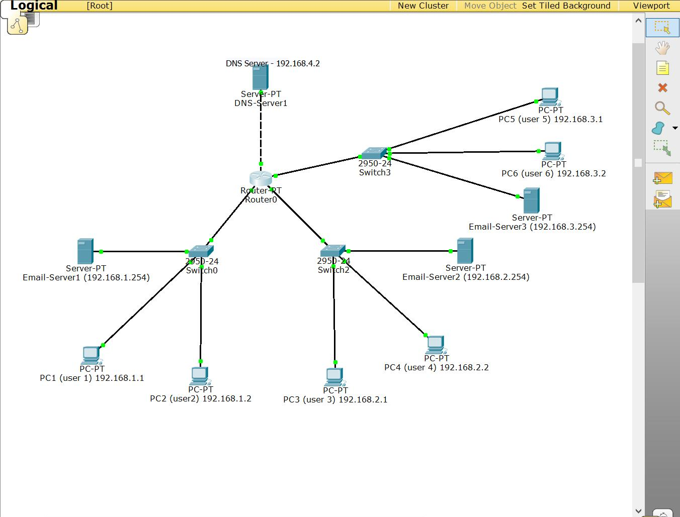
Overall Network Setup
We took Rugved’s lab setup and added a DNS server.

Slide 32
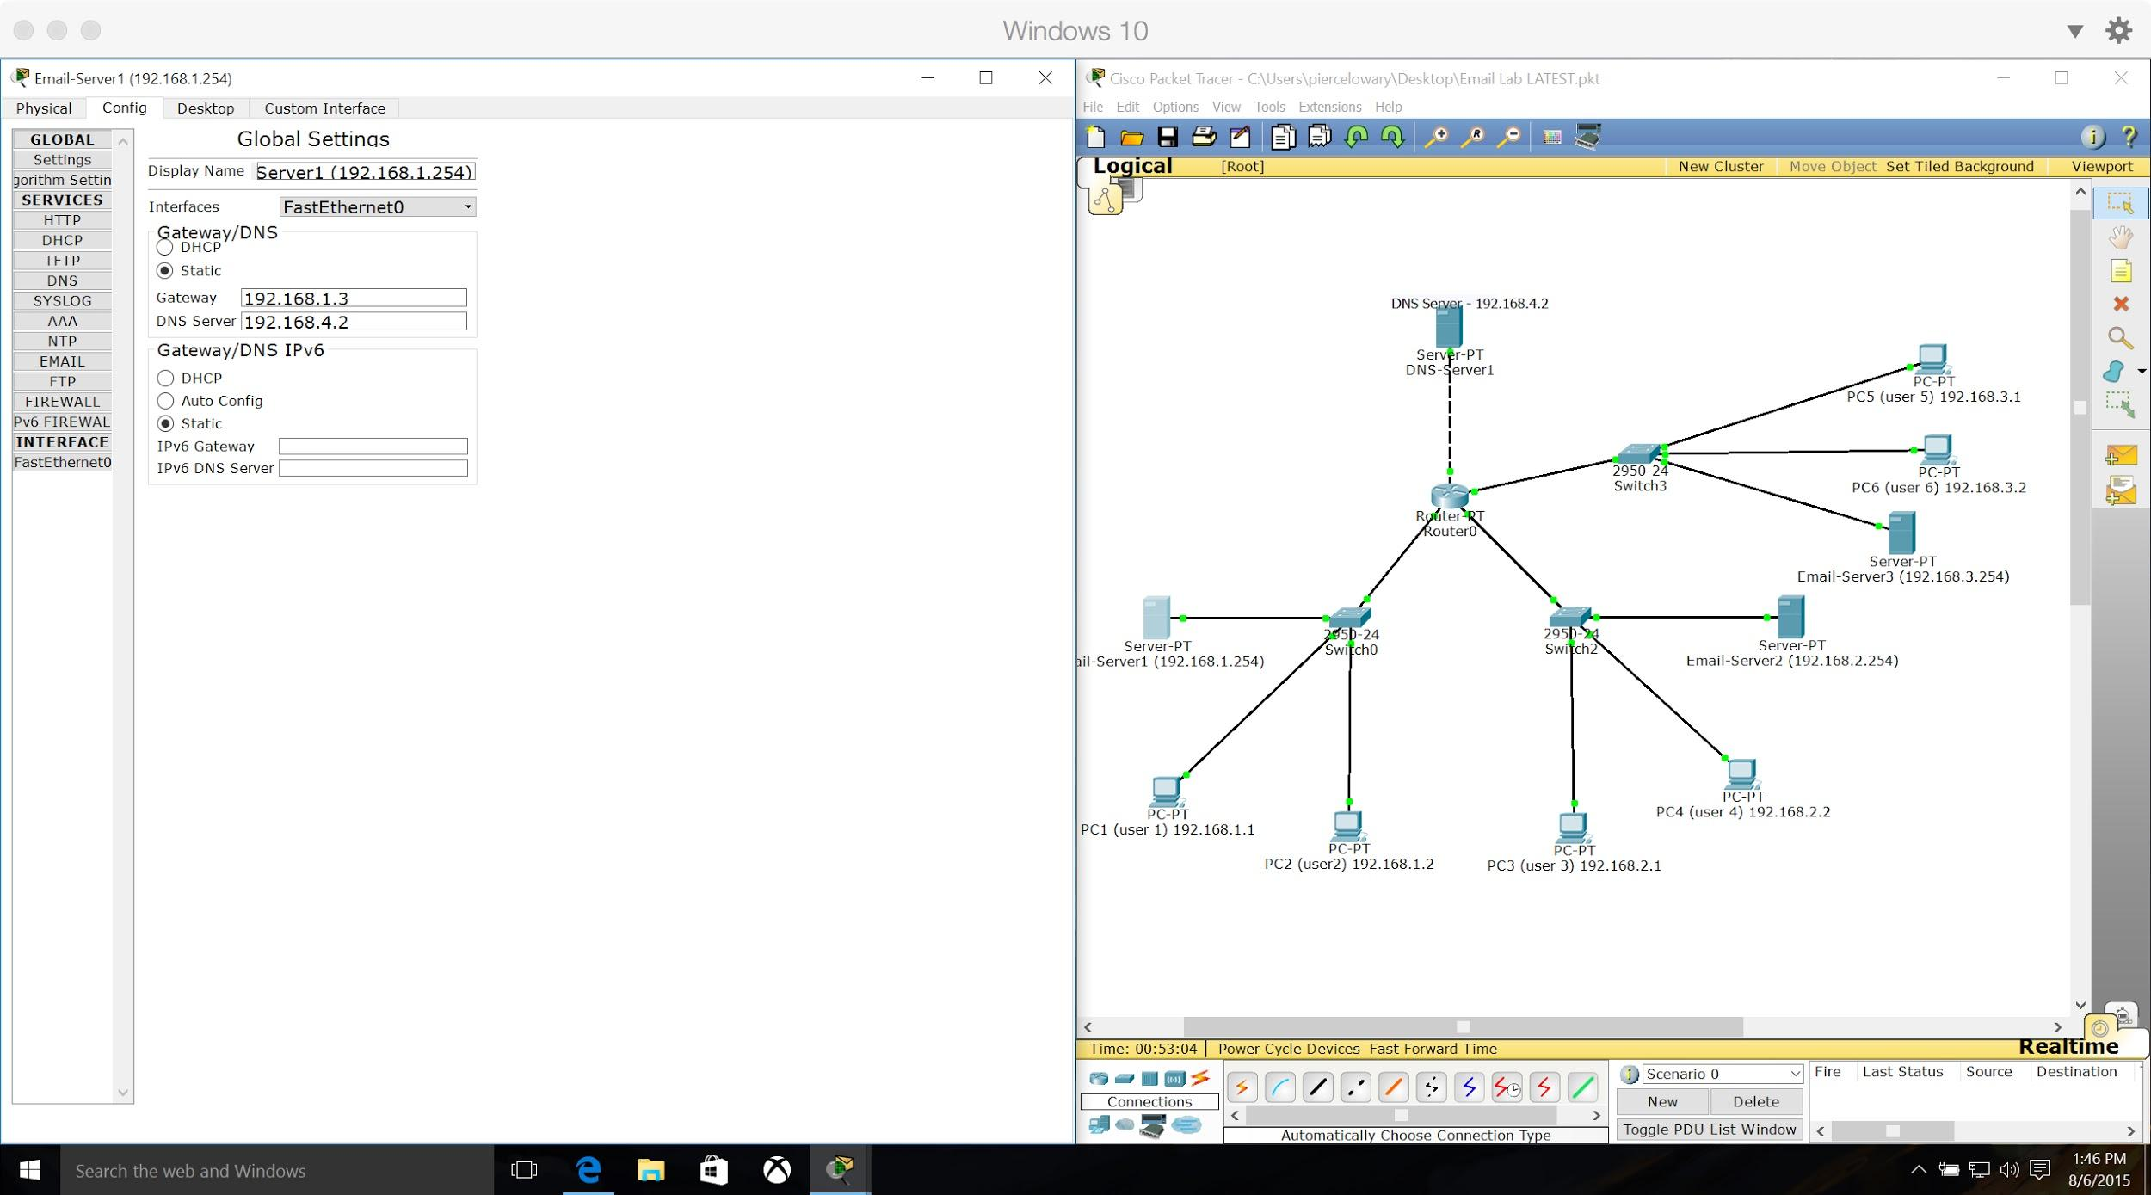
Email-Server1 Global Config

Slide 33
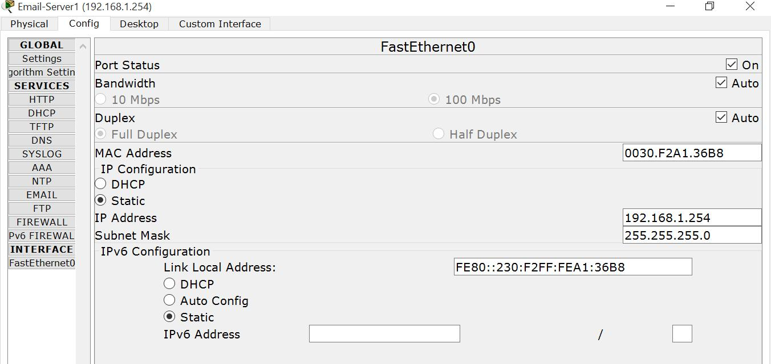
Email-Server1 Interface Config

Slide 34
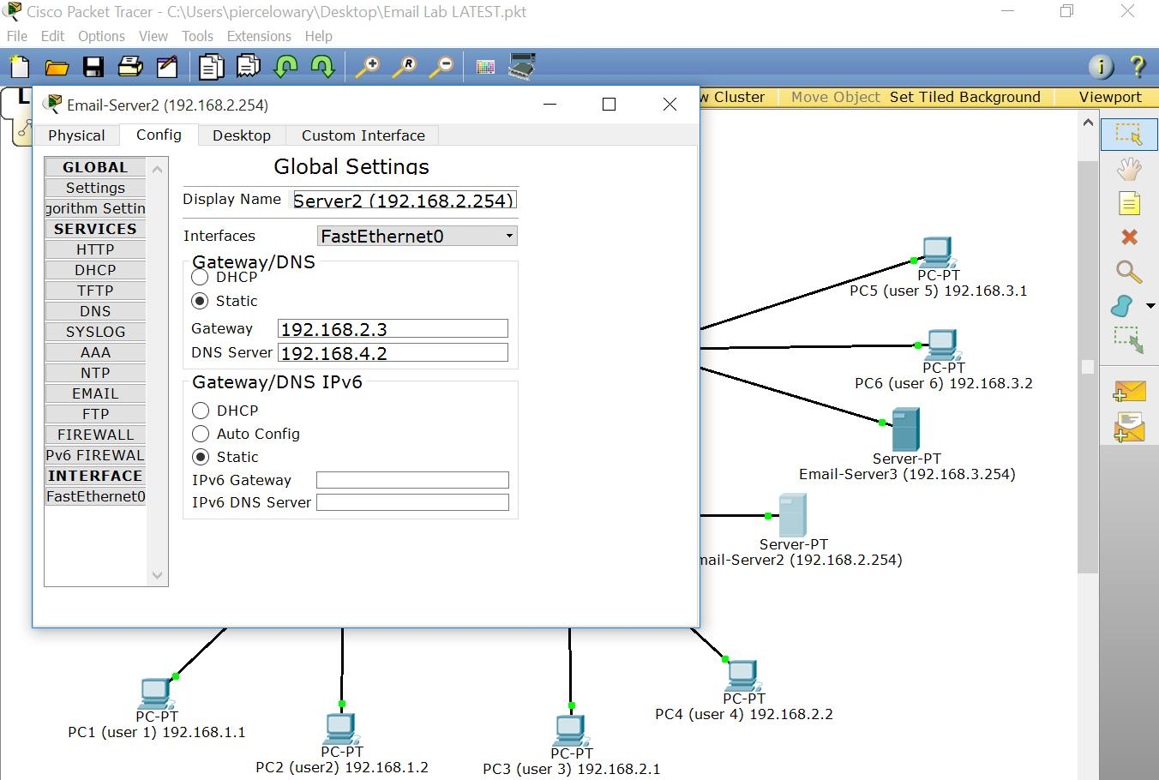
Email-Server2 Global Config

Slide 35
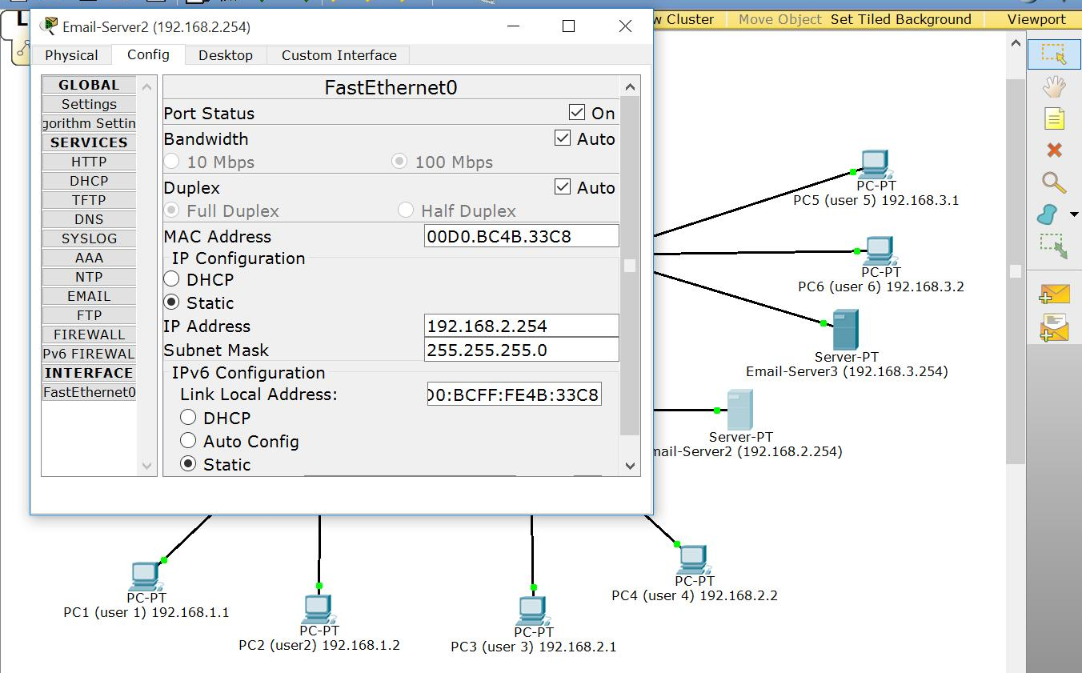
Email-Server2 Interface Config

Slide 36
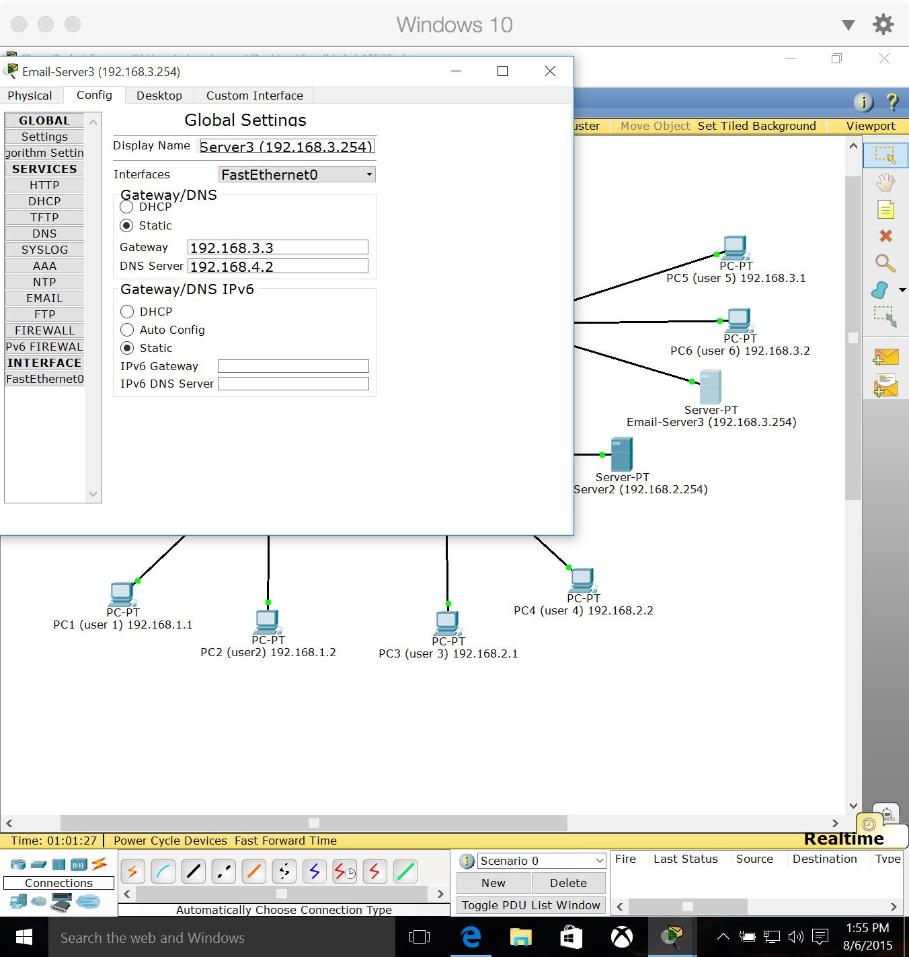
Email-Server3 Global Config

Slide 37
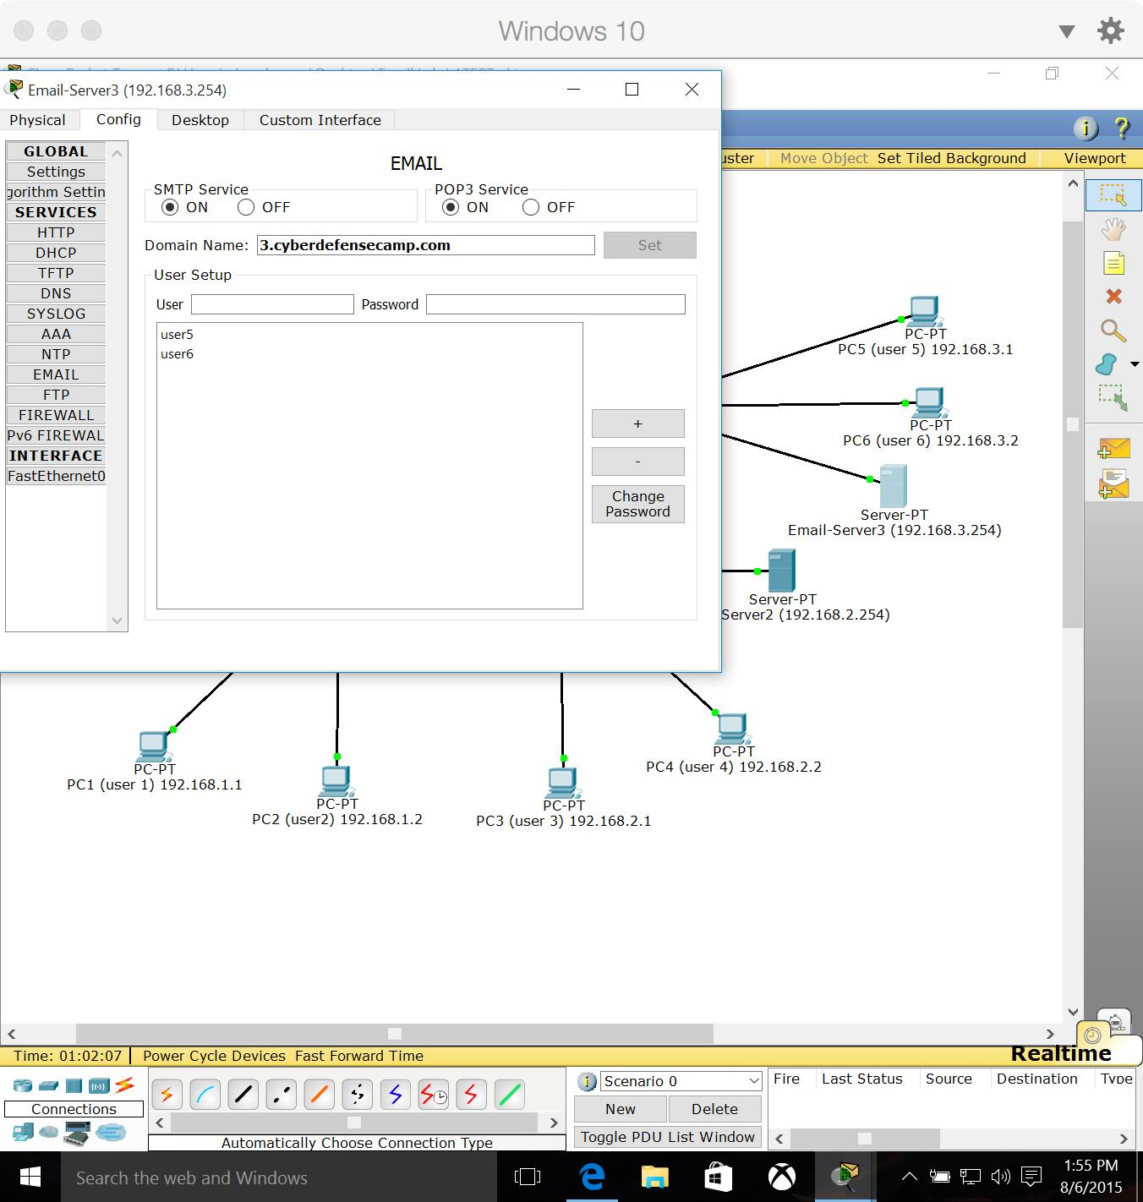
Email-Server3 Interface Config

Slide 38
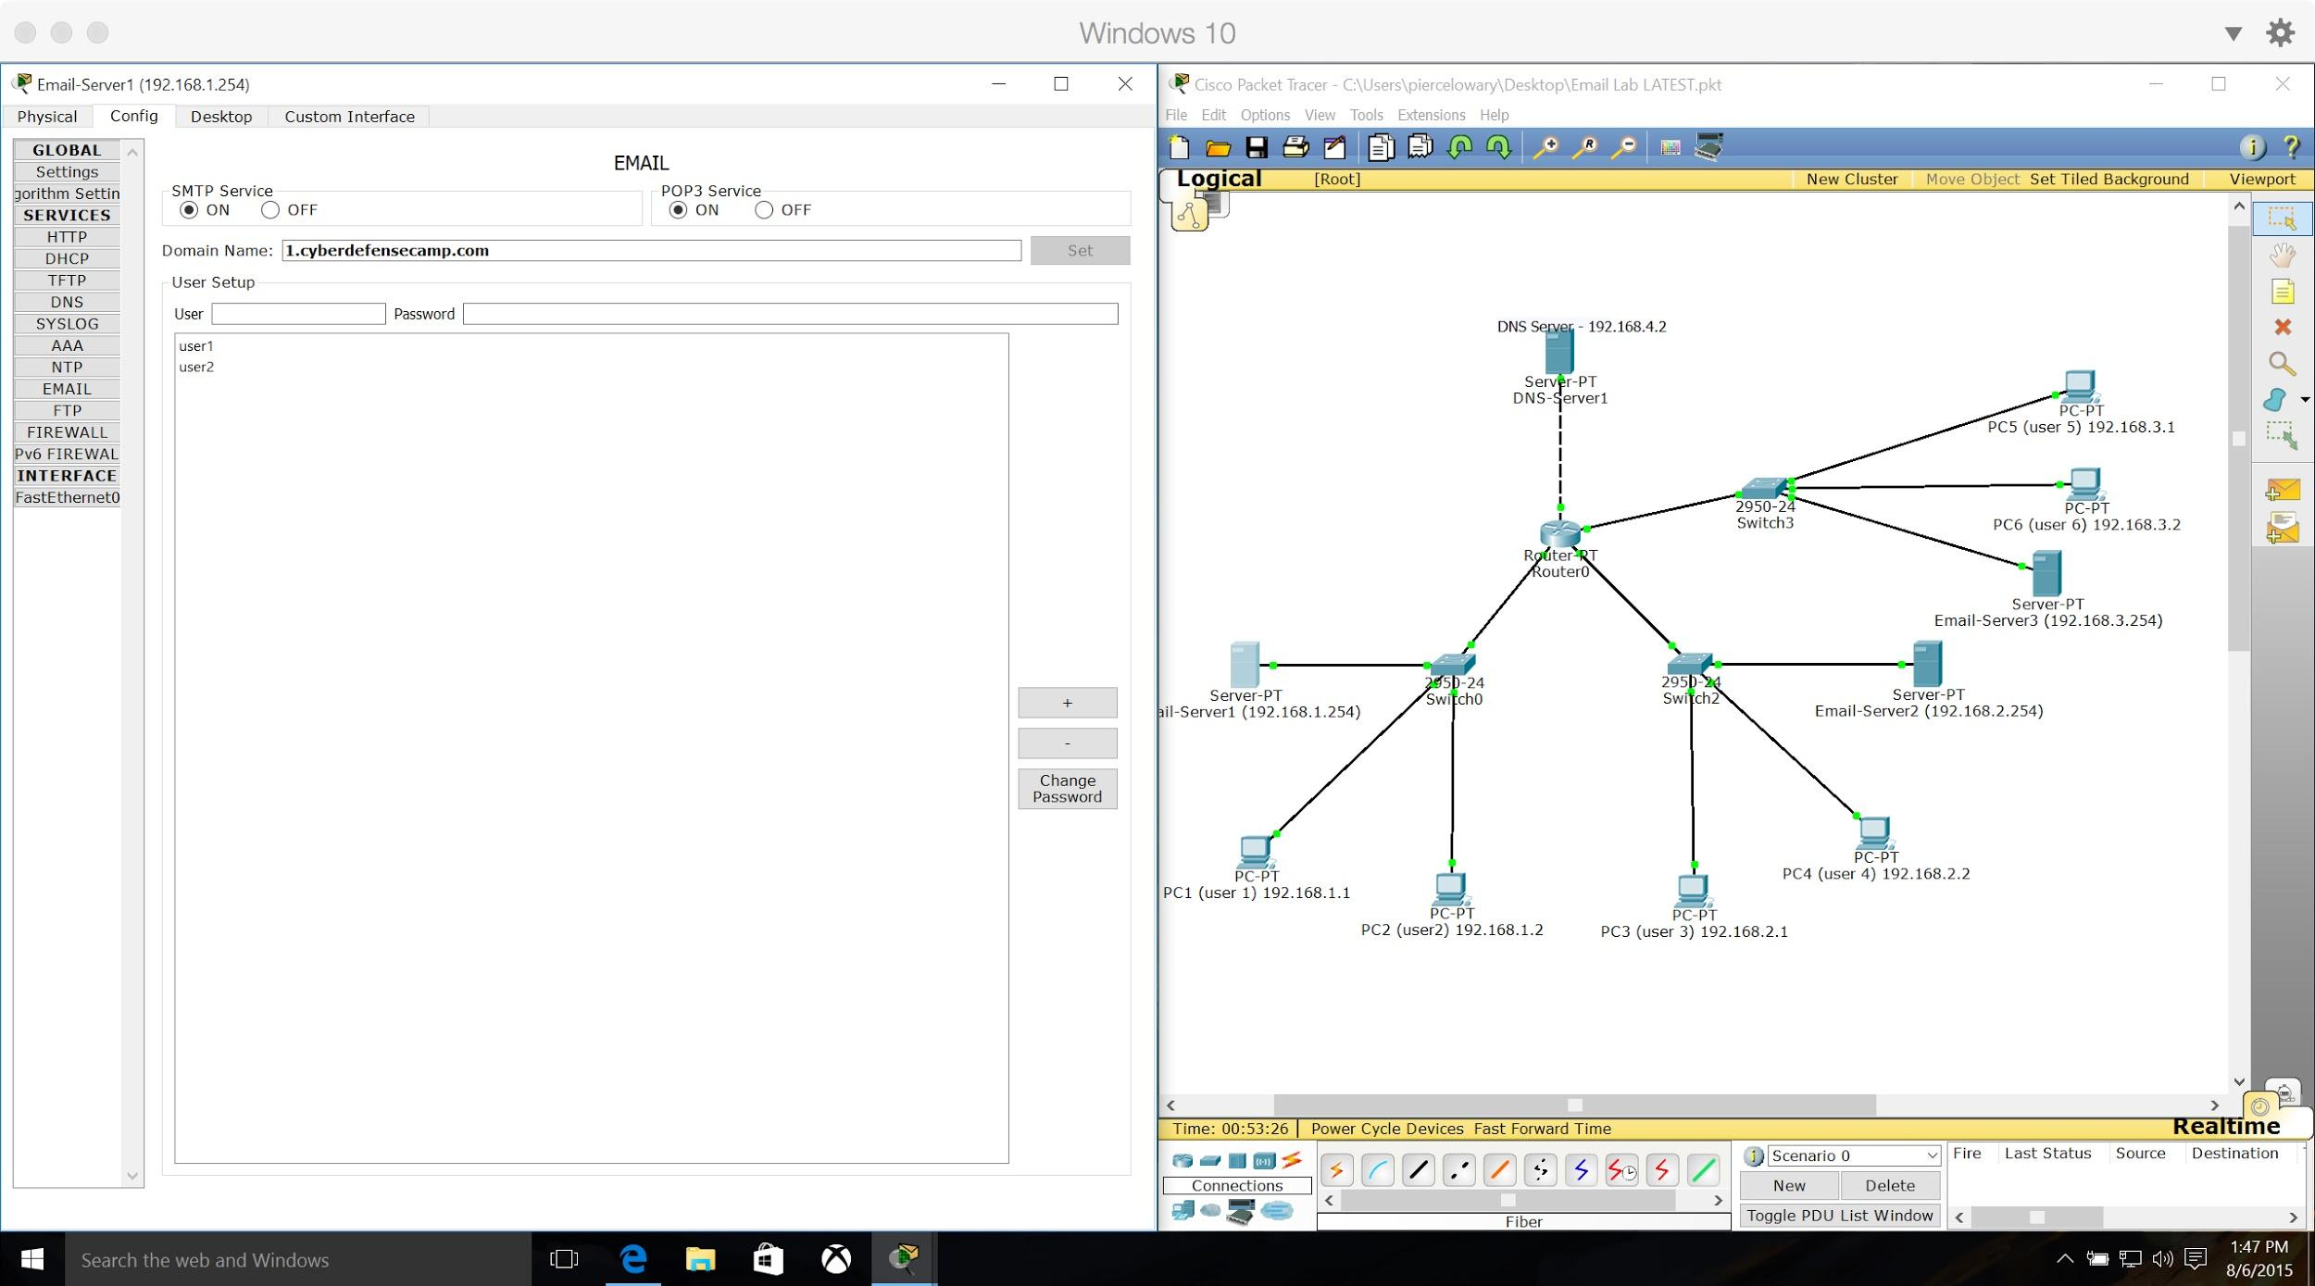
Email-Server1 Email Config

Slide 39

Email-Server2 Email Config

Slide 40
Email-Server3 Email Config

Slide 41
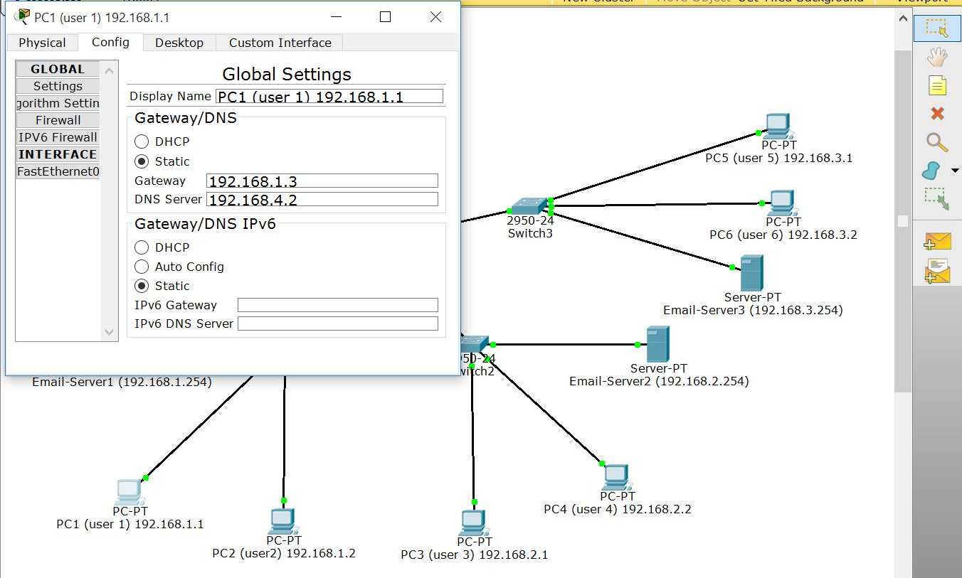
PC1 Global Config

Slide 42
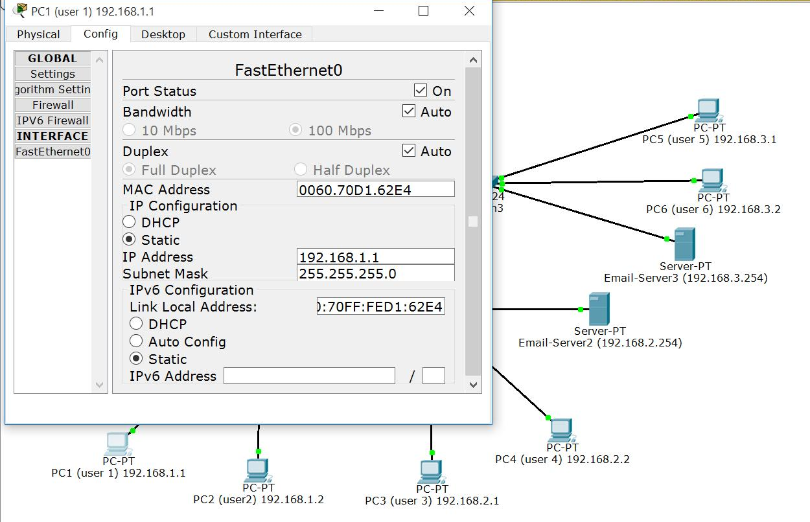
PC1 Interface Config

Slide 43
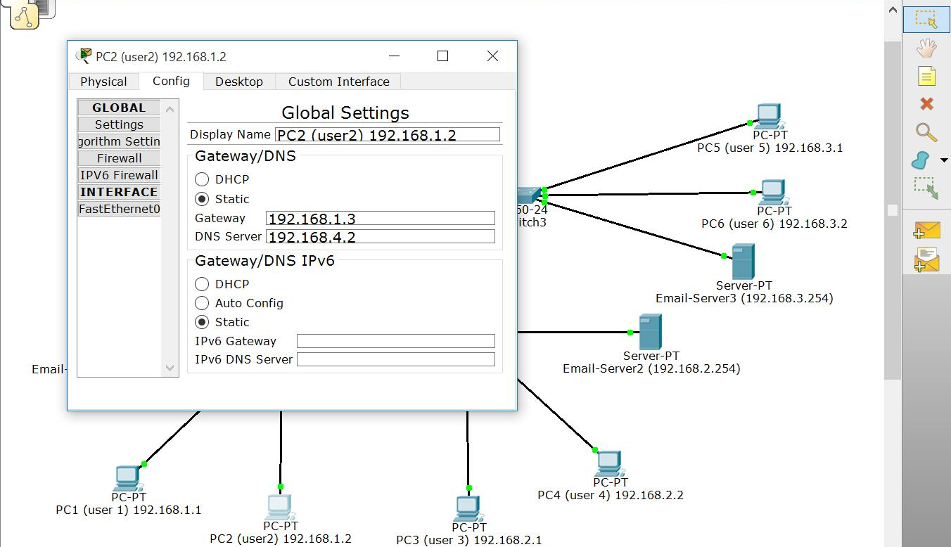
PC2 Global Config

Slide 44
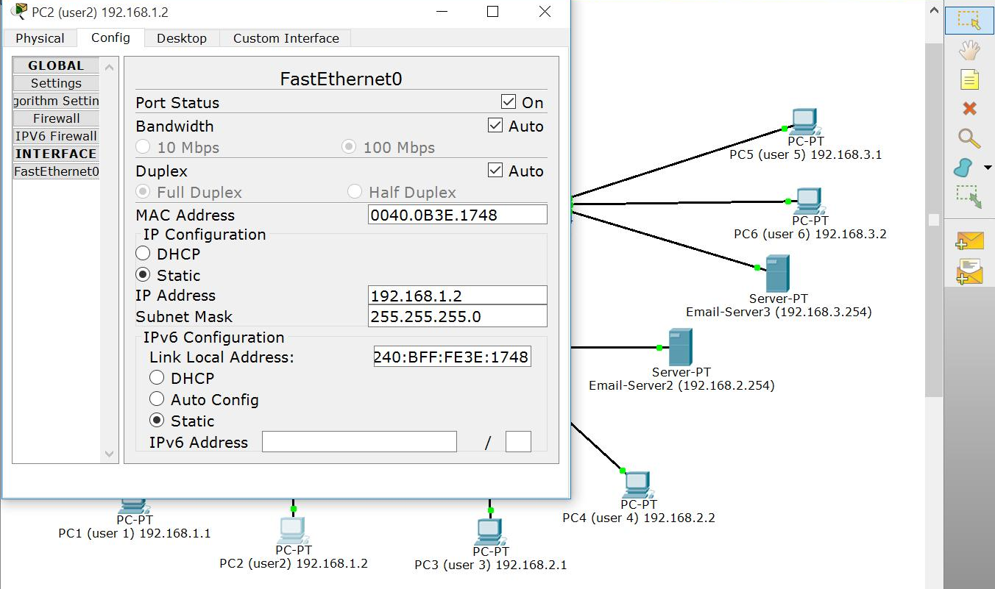
PC2 Interface Config

Slide 45
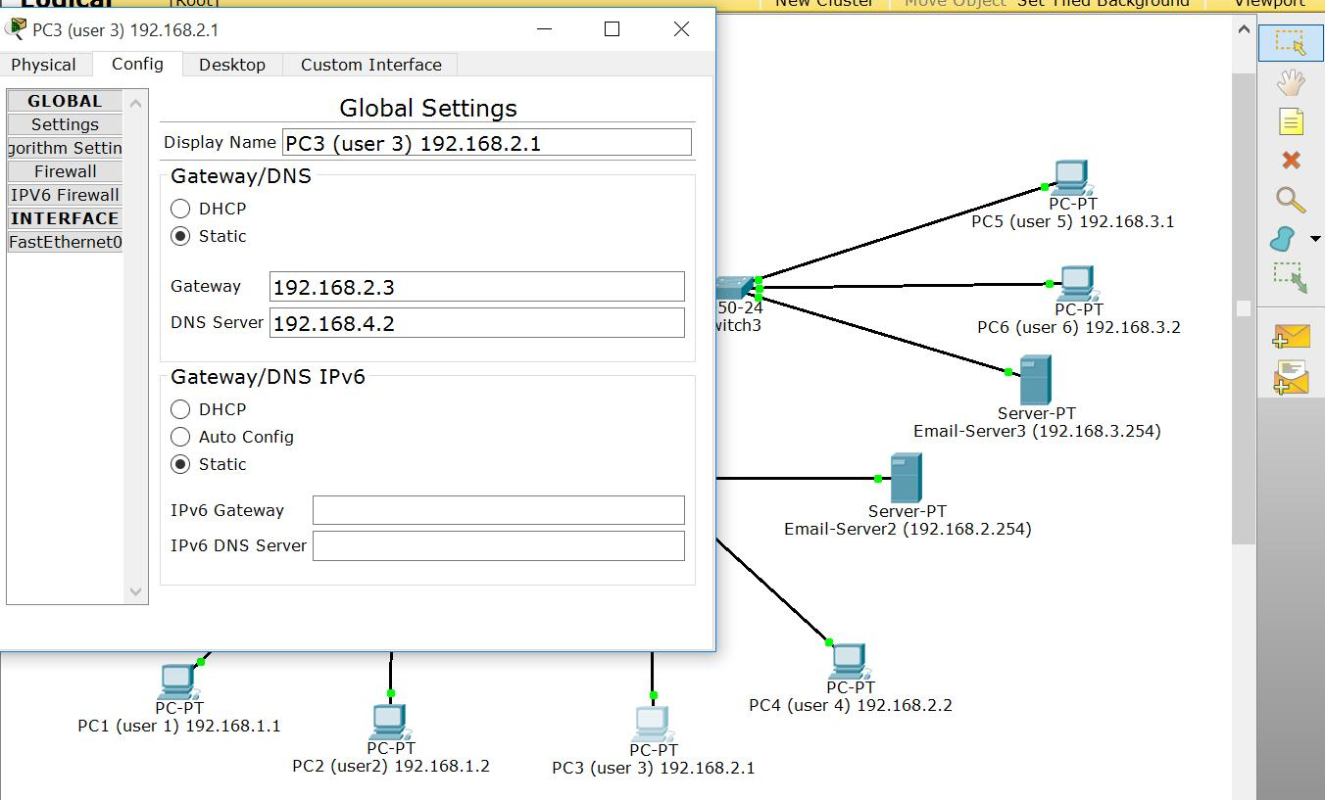
PC3 Global Config

Slide 46
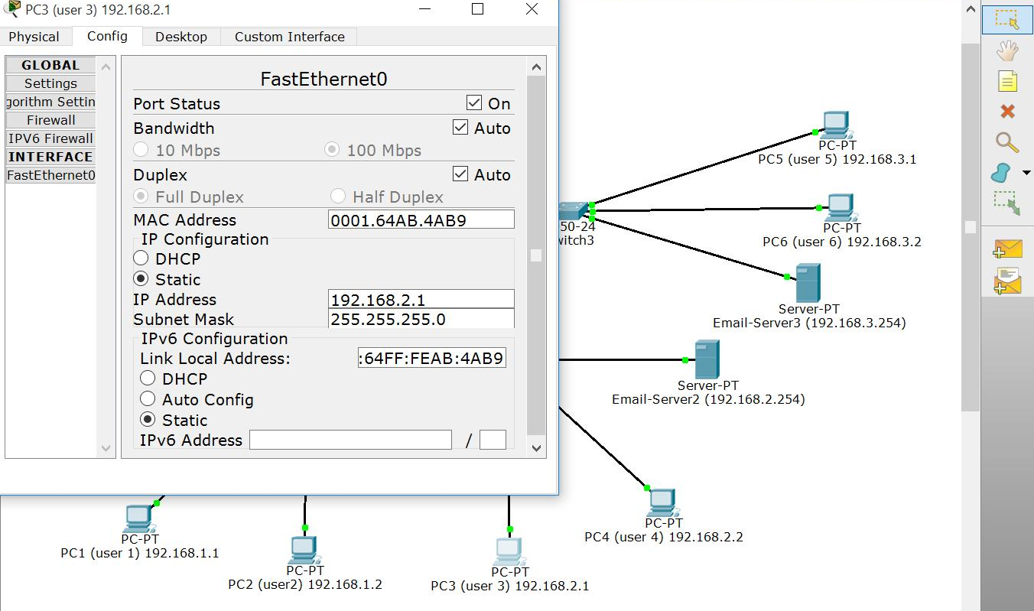
PC3 Interface Config

Slide 47
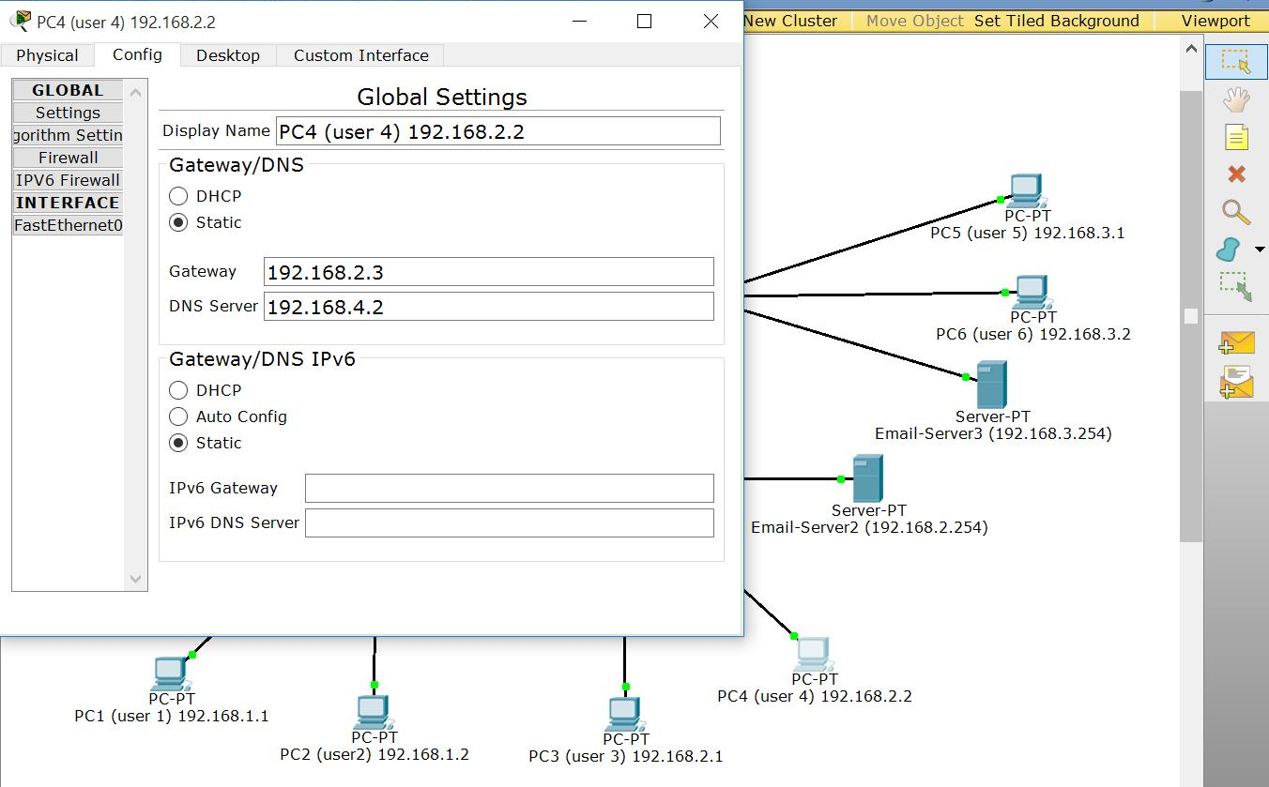
PC4 Global Config

Slide 48
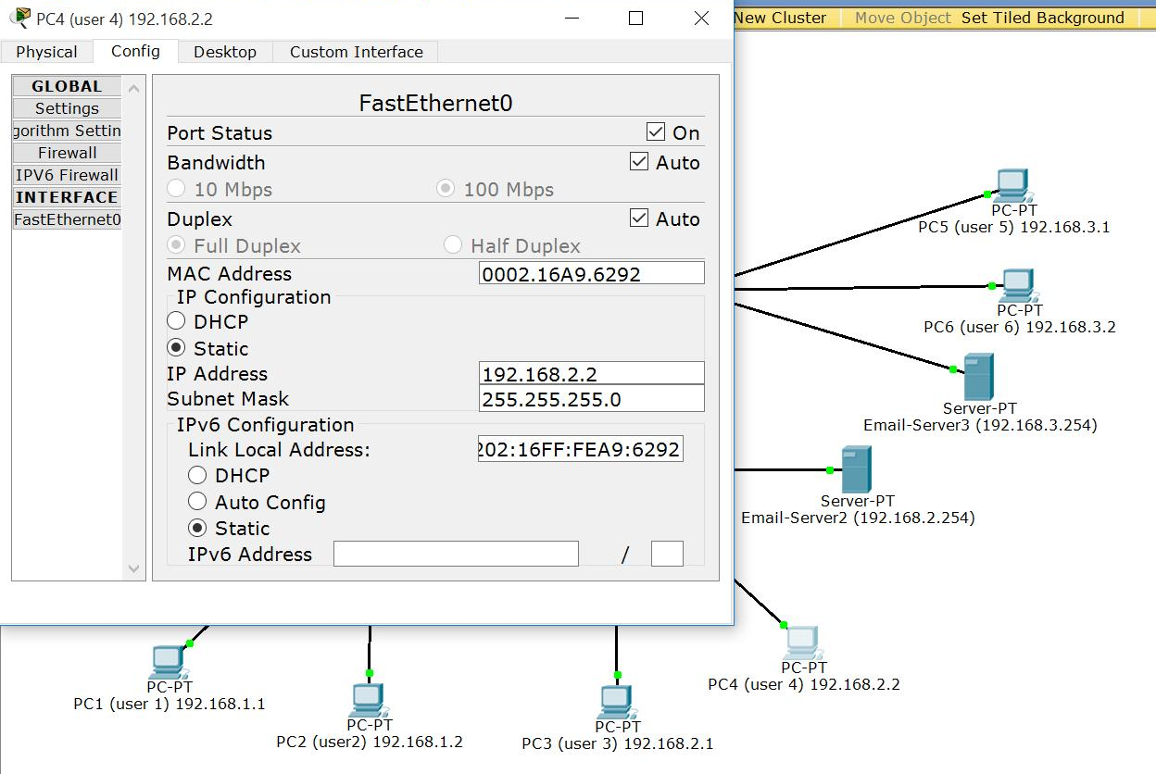
PC4 Interface Config

Slide 49
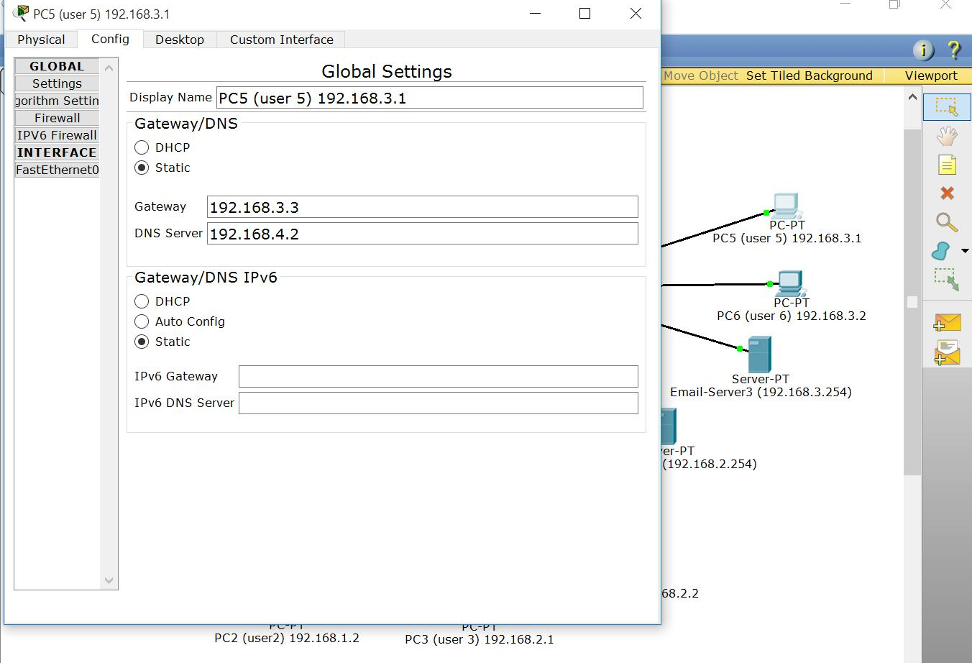
PC5 Global Config

Slide 50
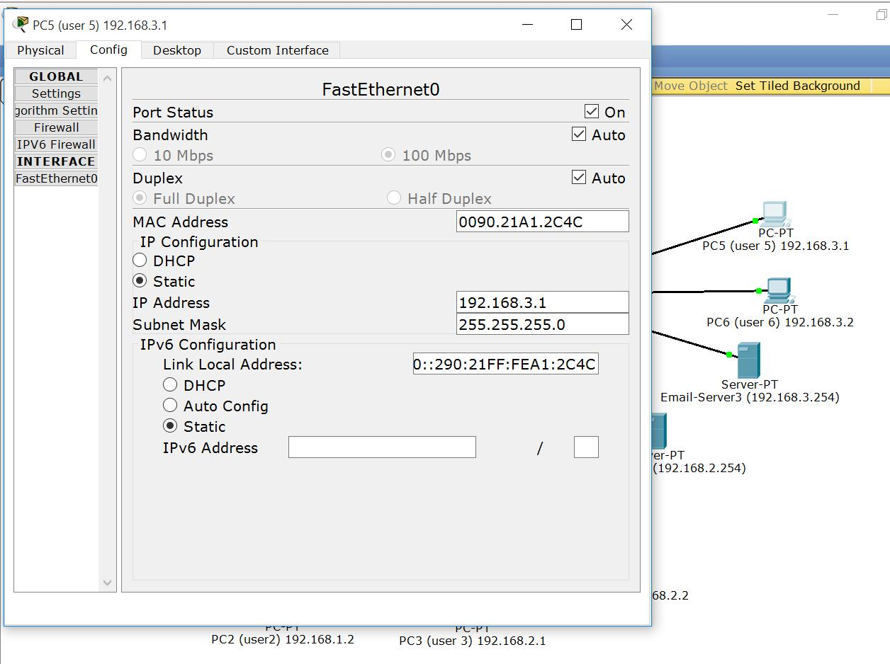
PC5 Interface Config

Slide 51
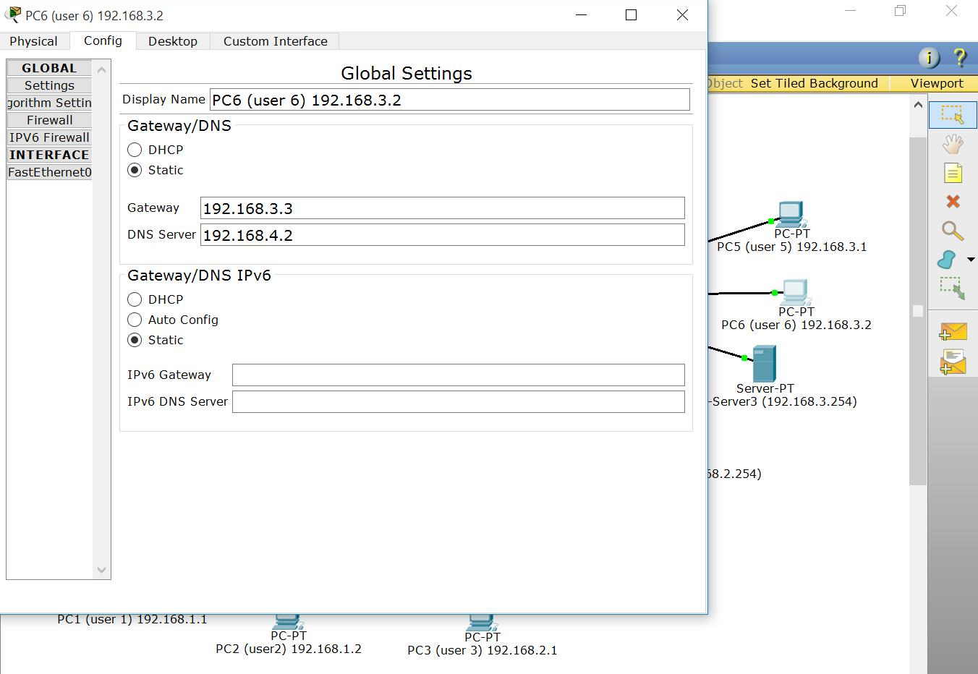
PC6 Global Config

Slide 52
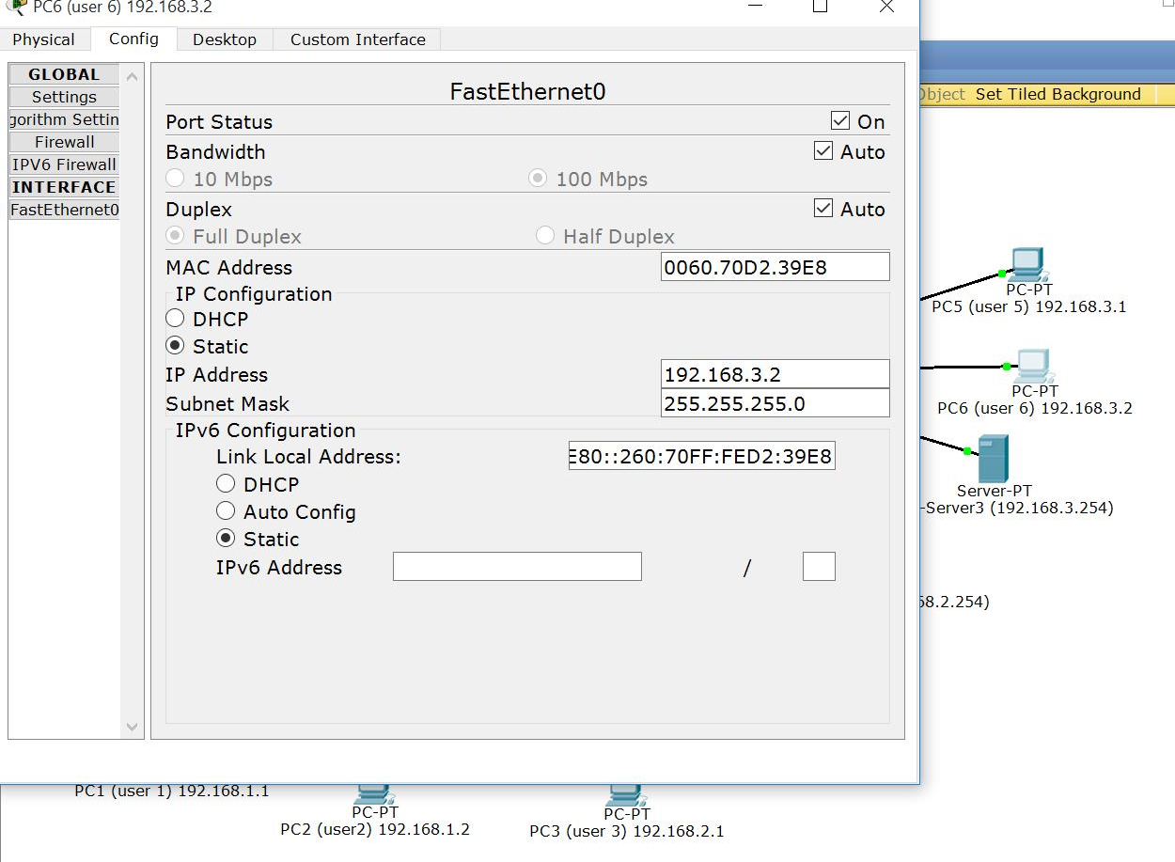
PC6 Interface Config

Slide 53
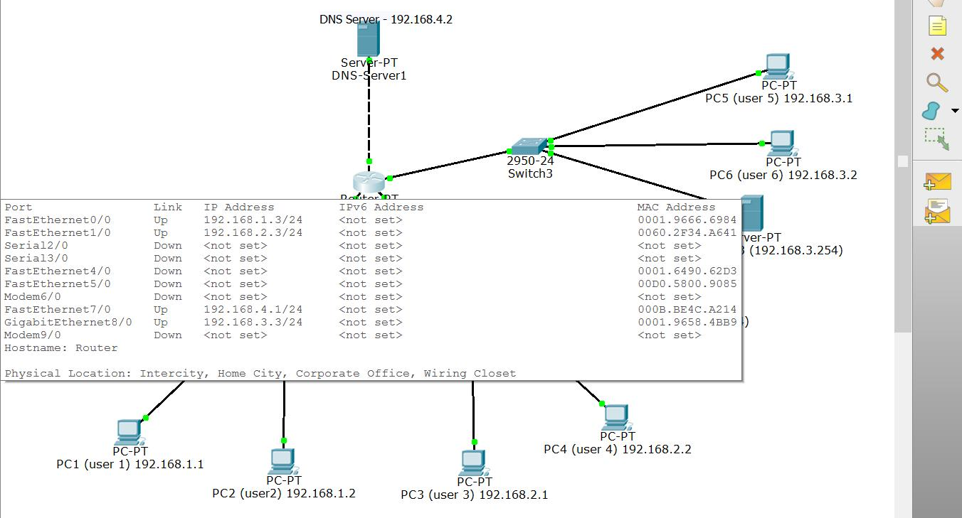
Router Configuration

Slide 54
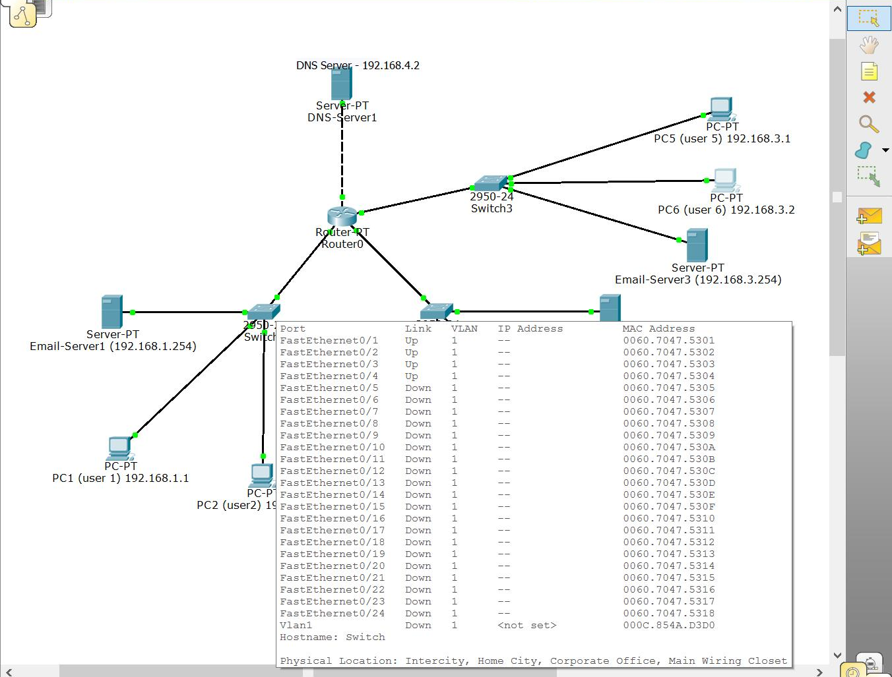
Switch1 Configuration

Slide 55
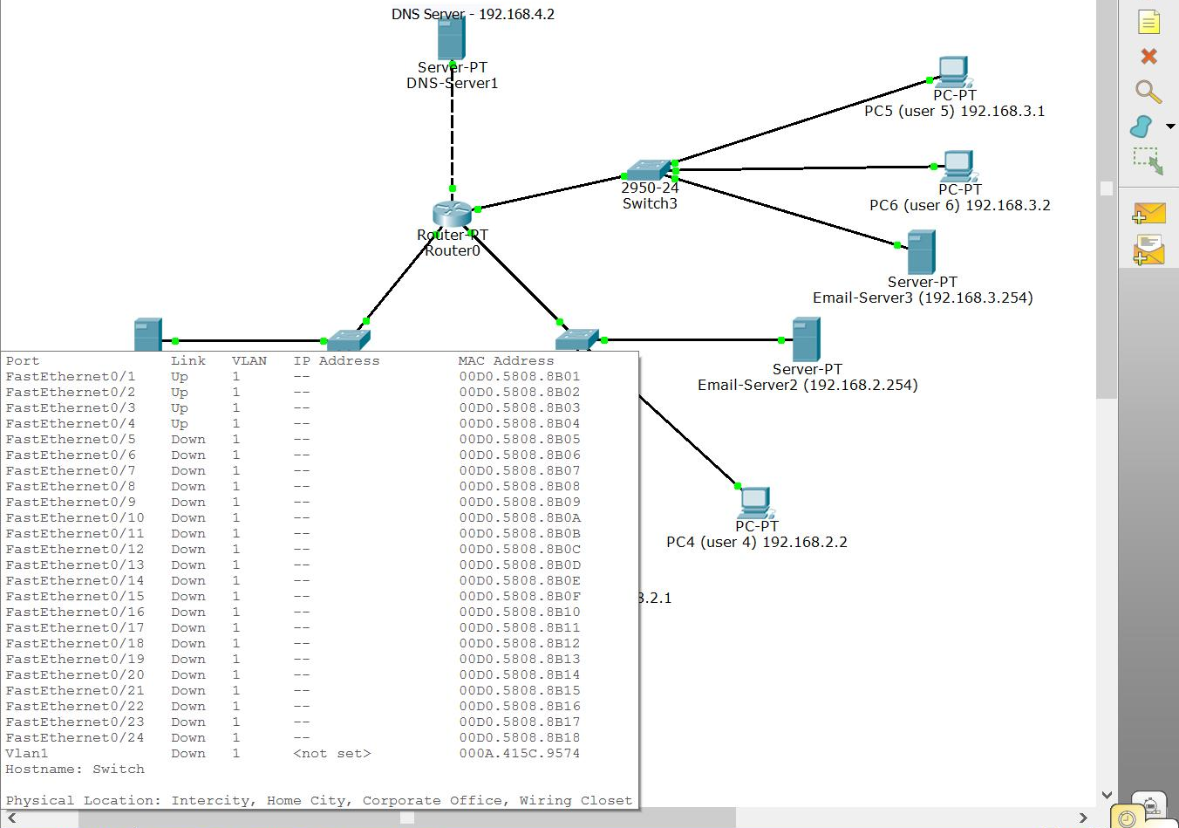
Switch2 Configuration

Slide 56
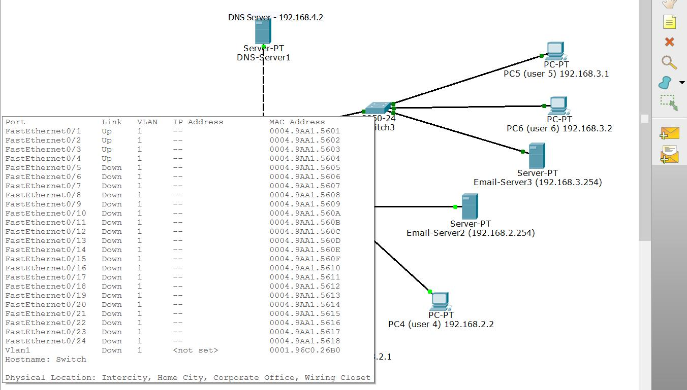
Switch3 Configuration

Slide 57

Now, DNS Configuration

Slide 58

DNS Server Global Configuration

Slide 59

DNS Server Interface Config

Slide 60
Why DNS?
I first attempted to use the same domain for all mail-servers. That didn’t work.
Packet Tracer could not distinguish between different mail-servers with the same domain name.

Slide 61
Why DNS?
Each mail server then got its own unique domain name.
1.cyberdefensecamp.com
2.cyberdefensecamp.com
3.cyberdefensecamp.com
I added each of these to the DNS record:

Slide 62
DNS Records
Each mail-server was told to use this DNS, and each client was told to just use the FQDN when referring to their mail-server. DNS made things easier.

Slide 63

Success
I sent an email from PC1 to every PC, then replied using every PC as a proof of concept. Every PC on the network is capable of sending and receiving email.

Slide 64
OSPF
Open Shortest Path First: an open source Link state routing protocol capable of running on all network routers.

Slide 65

Setting Up OSPF
Set up a configuration with 4 routers and 4 PCs

Slide 66


Set PC IP
Configure the IP by clicking on the PC and the going to IP Configuration and entering your static IP

Slide 67

Configuring Router IPs
Configure the routers’ IPs the same way we did in the last camp using the CLI

Slide 68

RIP Routing
Add all the subnets in the RIP Routing section of the router configuration

Slide 69

Commands and Confirmation
To configure OSPF use the command <hostname> ospf <number> then type network <pc network> <reverse submask> area <id>. Type the command 2 more times with the networks of the 2 other router interfaces. Once you do that on all the routers you'll get a message that everything is connecting

